Slide 1

Department of Computer Science Gujarat University
M.Sc.(Artificial Intelligence & Machine Learning) – I
PERFORMANCE COMPARISON OF NLP LIBRARIES FOR THE PROBLEM OF FRAUD MESSAGE DETECTION
Presented By:
JHA ANJU (04)
NAGAR PRIYANSHI (DS-04)
PANDYA DIPALI (DS-05)
Under the Guidance of :
Dr. SUCHIT PUROHIT

Slide 2

Introduction
In this presentation, we will explore how NLTK, RE and Pattern libraries that can enhance fraud message detection. We will discuss the challenges of fraud detection and how natural language processing techniques can be leveraged to improve accuracy and efficiency.

Slide 3
Defining flow of Programming
Collection of data set: We have collected the data from https://www.kaggle.com which was unstructured as the total data was not balanced in between ham and spam.
So, we have structured it by removing ham and balancing the data. So that data mining can be done easily. Our data set is in text form.
On the dataset we are going to do following processes:
Labelling the columns.
Polarity of the text.
Cleaning and Preprocessing the data.
Splitting data for train and test.
Feature Extraction.
Classification
Evaluation
Validation

Slide 4
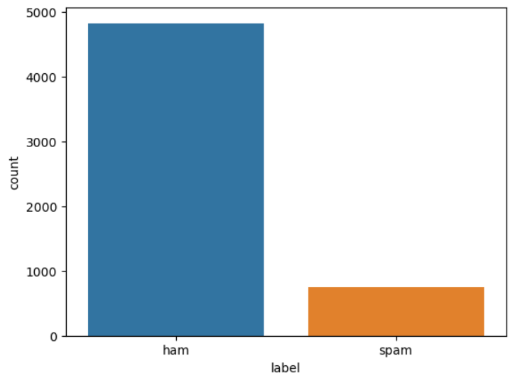
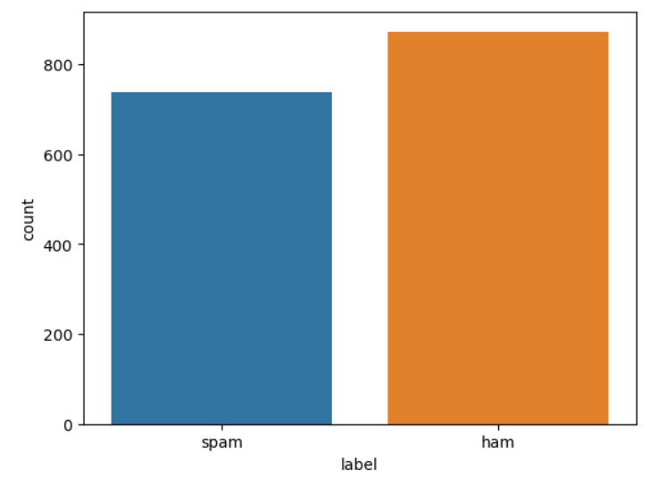
DATA BALANCING

Slide 5
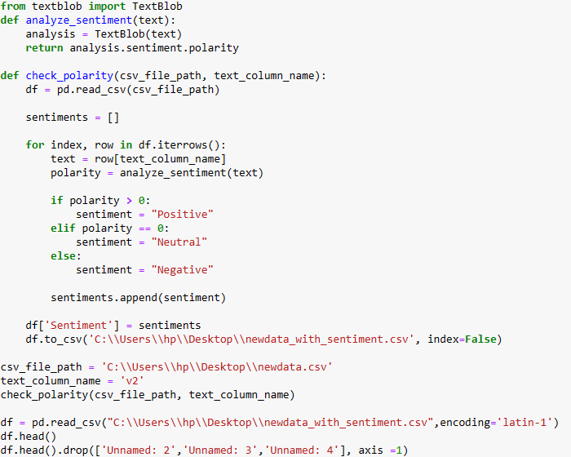
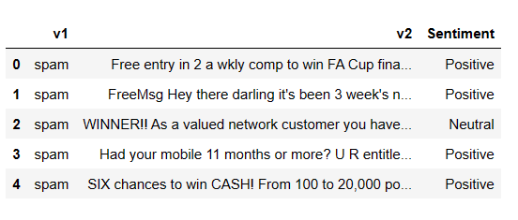
POLARITRY

Slide 6
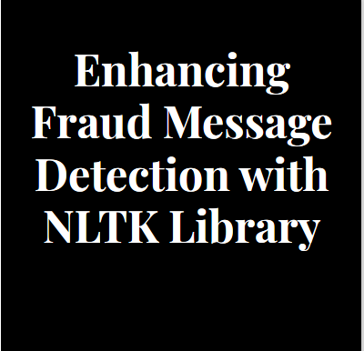
Natural Language Tool-Kit (NLTK) Library
The Natural Language Toolkit (NLTK) is a powerful library for natural language processing in Python. It provides tools for tokenization, stemming, tagging, parsing, and semantic reasoning, making it an ideal choice for analyzing and understanding text data

Slide 7
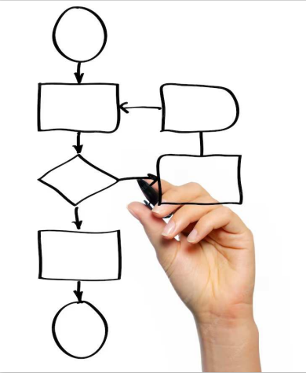
DATA PRE-PROCESSING
Before applying fraud detection algorithms, text data must undergo preprocessing. This includes tasks such as tokenization, removing stop words, and stemming. NLTK offers efficient methods to perform these tasks, improving the quality of input data for fraud detection models.

Slide 8
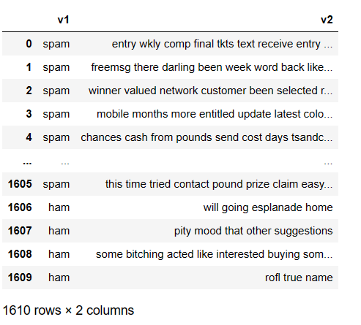
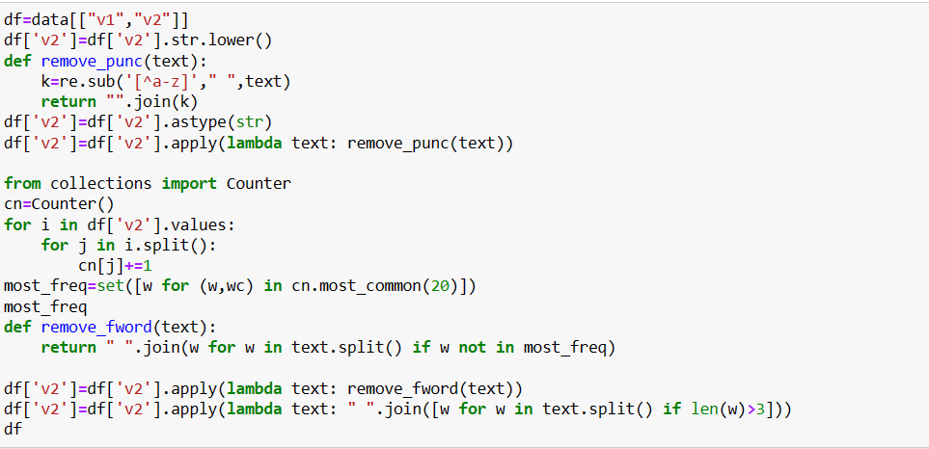
DATA PRE-PROCESSING

Slide 9
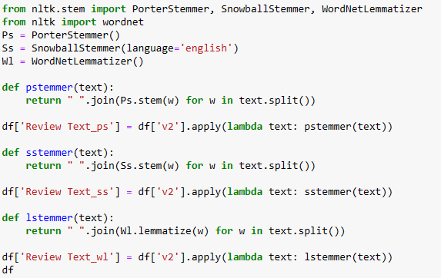
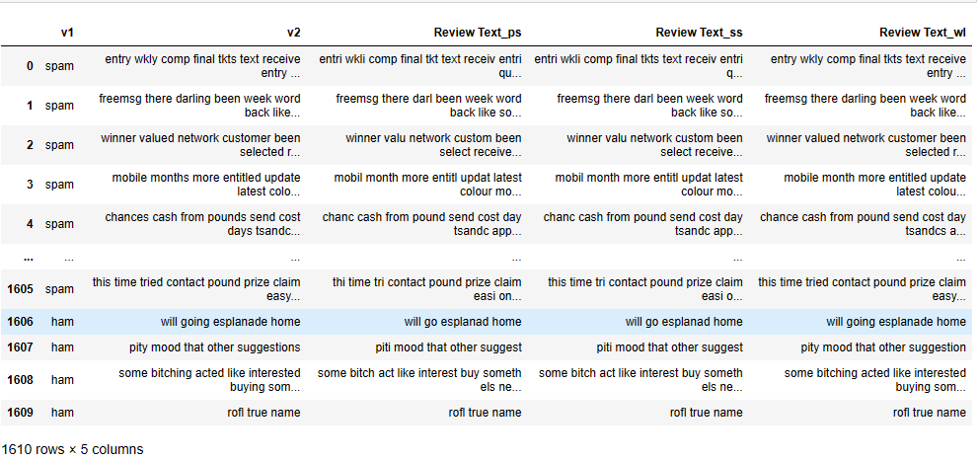
DATA PRE-PROCESSING

Slide 10
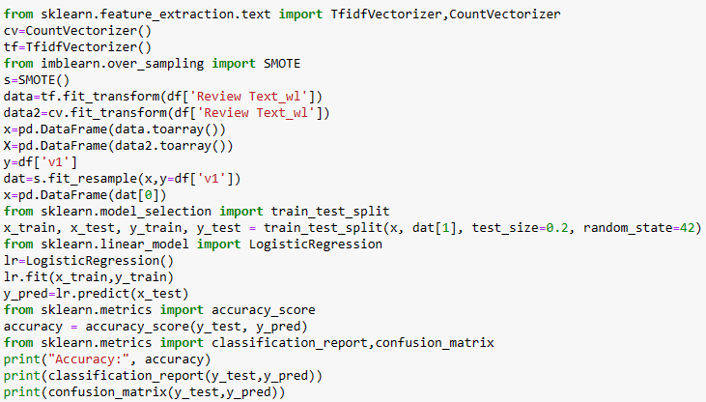
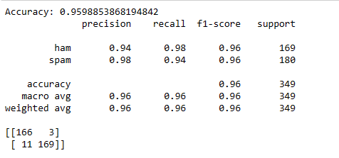
CLASSIFYING DATA AND PREDICTION MATRIX

Slide 11
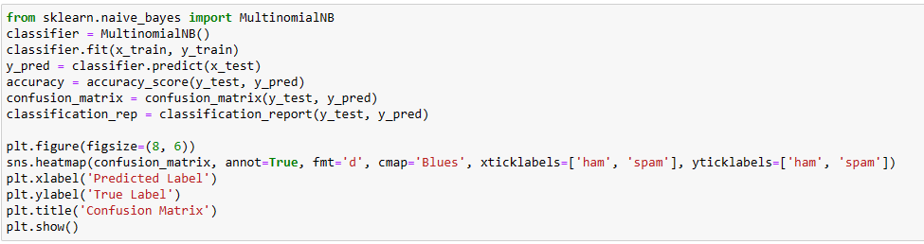
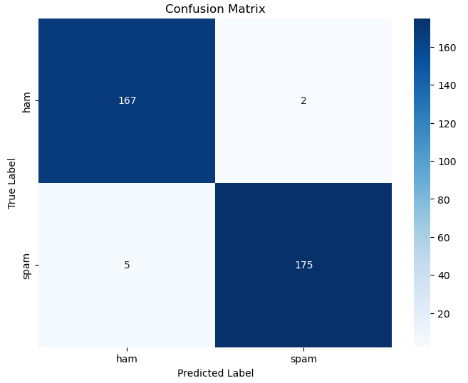
Evaluation of model

Slide 12
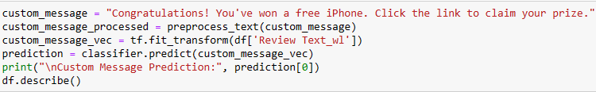
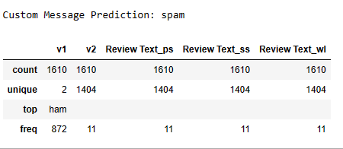
Testing the model

Slide 13

RE LIBRARY
The re library is known for its powerful regular expression capabilities, which are useful for pattern matching and text manipulation. However, its performance in detecting complex fraud patterns needs to be evaluated thoroughly
Methods of RE(REGEX) library:-
Search
Findall
Split
Sub

Slide 14
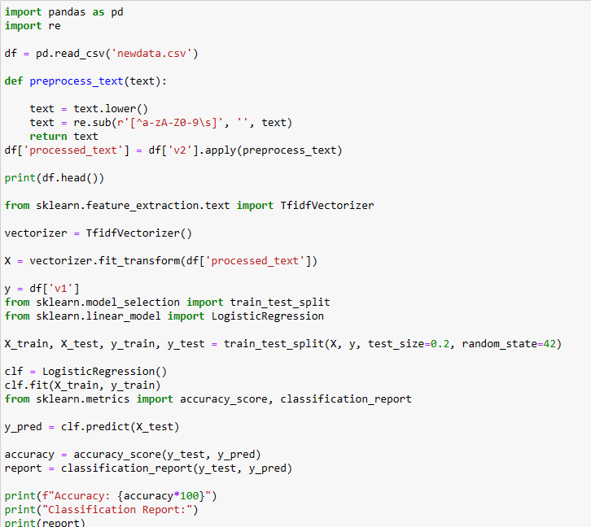
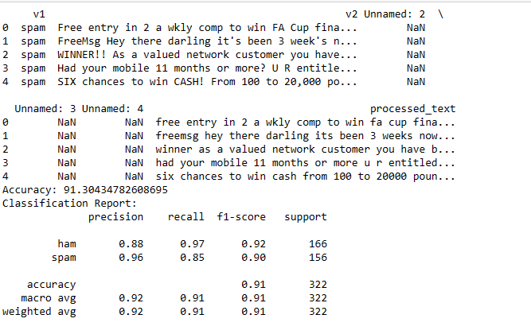
Predictions using RE Library

Slide 15
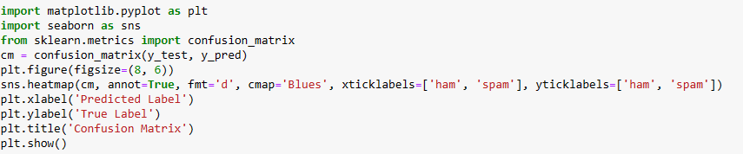
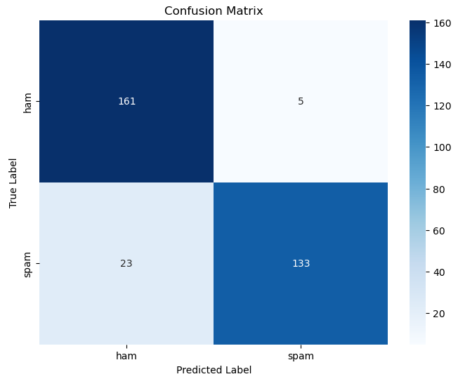
Evaluation of model

Slide 16
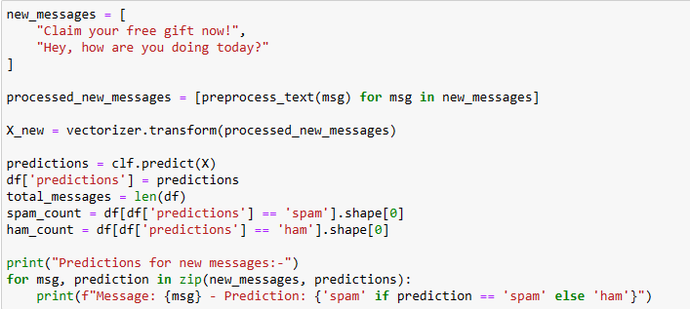

Testing the model

Slide 17

Pattern Library
Establishing a systematic approach to cataloging and categorizing various fraudulent message patterns. Emphasizing the significance of consistency and scalability in library development.

Slide 18
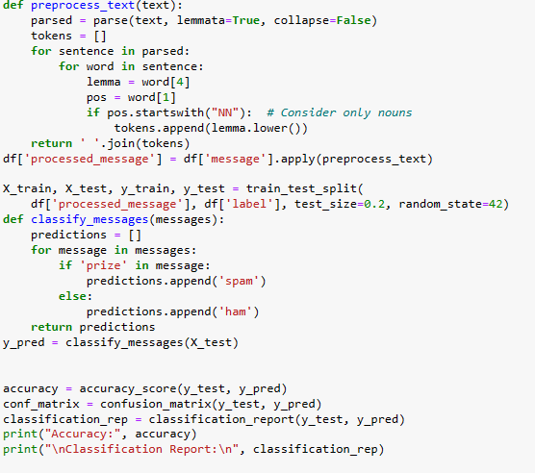
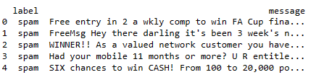
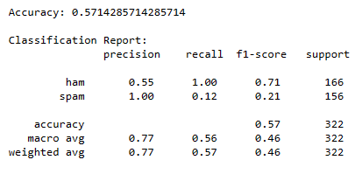
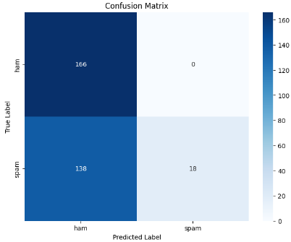
Predictions using Pattern Library

Slide 19
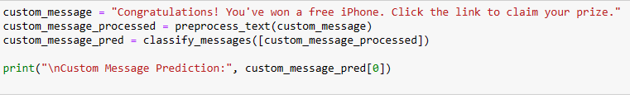

Testing the model
OUTPUT

Slide 20
Conclusion
In conclusion, this presentation has provided a comprehensive analysis of NLP libraries for fraud message detection. It has highlighted the strengths, limitations, and future research directions in this domain.
Leveraging the NLTK library for fraud message detection offers promising opportunities to enhance accuracy and efficiency. By harnessing the power of natural language processing, organizations can strengthen their defenses against fraudulent activities and safeguard their assets.
The ‘re’ library in Python offers a powerful toolkit for detecting and preventing fraudulent messages. By leveraging re, organizations can strengthen their security measures and protect against potential financial losses and reputational damage caused by fraudulent content.
Summarizing the pivotal role of a robust pattern library in combatting fraud messages. Encouraging ongoing refinement and expansion of the library to adapt to evolving fraud tactics.

Slide 21
THANK YOU !!!

